Slide 1
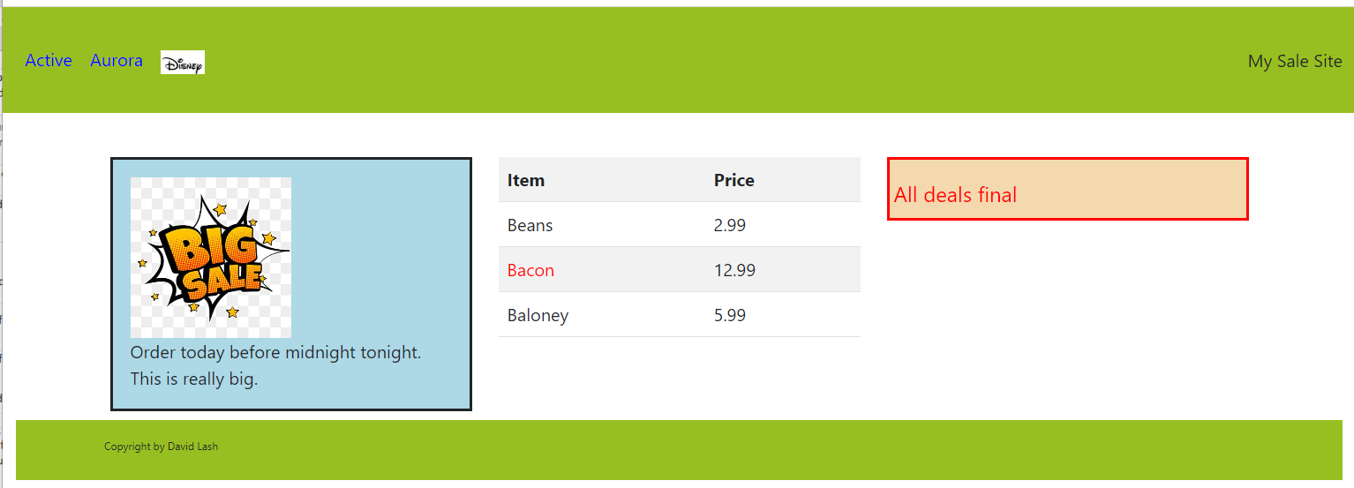
R1 Use bootstrap to build this page with a CDN
And use an embedded CSS style
R3 Make this nav bar color #98bf21 and a height of 120px
R2 Make link go to aurora.edu
And when click this image go to disney.com … scale this image to fit nicely
R4 Put 3 columns of data here. 1/3 of screen 1/3 screen and 1/3 of screen when screen size is large or more
R8- make this text red using a common CSS class
R6 - Make text 20 px from top, 10 px from bottom and 5 px from the left and background: #f4d8ae; with a border that is red and 3px size
R5 Make this a striped table with headers and these contents
R7 - Make text 20 px from left and top and bottom and background: lightblue with a border 3px and put image here properly scaled
R9 - Use semantic tag with
Color #98bf21 100px from left and 20 from top and bottom and 10 px gap here. Make text only 10pixels using a unique css id in size (and use your name)

Slide 2
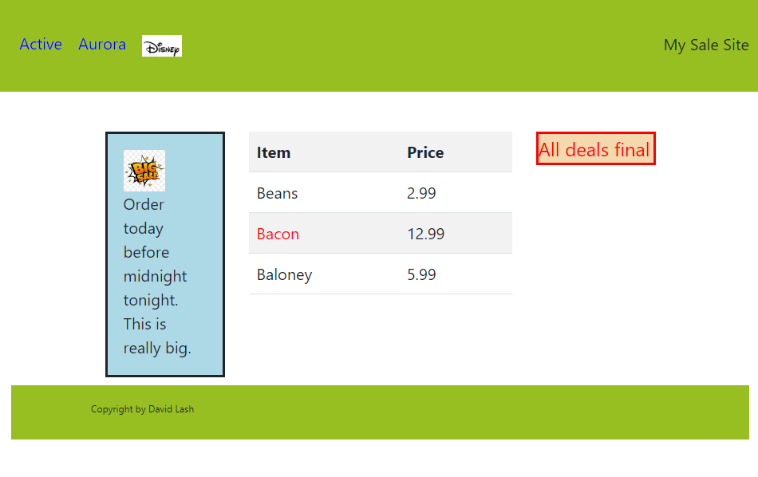
R10 When the screen size is med to large make
the left column 25%,
the middle 50%
and the right 25%

Slide 3
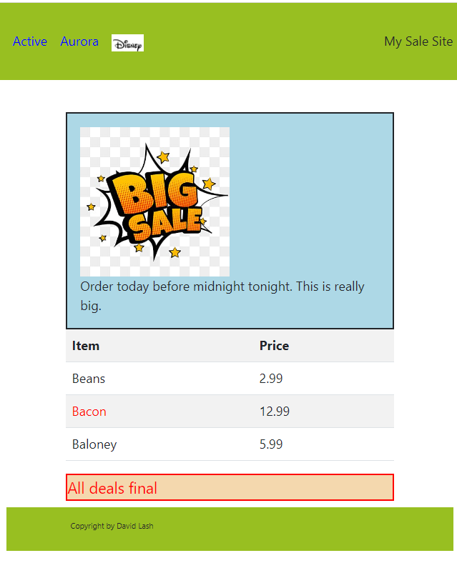
R11 - When the screen size is less than small … stack the columns like this
R12 – make sure all images are friendly to people who use screen readers or have graphics turned off

Slide 4
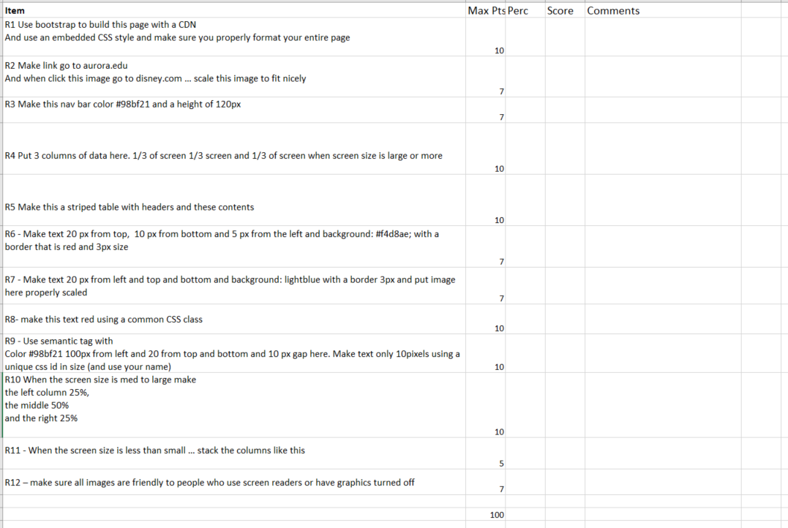
Requirement check list and rubric
What you hand in… all your work should be in 1 file. Upload that one html file

